Slide 1

Emotion Classification and Textual Clustering Techniques for Gang Intervention Data
IEEE Big Data Workshop on Data Science for Smart and Connected Communities
December 2020
Ruofei Wu, Chenxin Yang, David Hyde, Andrea L. Bertozzi, P. Jeffrey Brantingham

Slide 2


Introduction
The Gang Reduction Youth Development (GRYD) Intervention Family Case Management (FCM) program funded by the City of Los Angeles Mayor’s Office aims to reduce gang embeddedness of gang-involved youth and young adults between ages 14-25.
Participants who engage with GRYD FCM services are asked to complete the Social Embeddedness Tool (SET) questionnaire, which asks about family background, substance use, lifestyle, personality, gang involvement, gang-related activity, and many other attitudinal and behavioral features.
Notes:
Since 2008, the City of Los Angeles Mayor’s Office Gang Reduction \& Youth Development Office has funded prevention and intervention services throughout the city as part of a comprehensive strategy to address gang violence. The GRYD Intervention Family Case Management (FCM) Program is designed to increase youth and family protective factors and resiliency, while reducing gang embeddedness for gang-involved youth and young adults between ages 14--25. Participants who engage with GRYD FCM services are asked to complete the Social Embeddedness Tool (SET) questionnaire \cite{cahill2015evaluation}, which asks about family background, substance use, lifestyle, personality, gang involvement, gang-related activity, and many other attitudinal and behavioral features. The intent of the SET instrument is to evaluate how close an individual is to the center of the gang (i.e., gang embeddedness) and to record a broad collection of covariates. While many participants only complete the SET questionnaire once, others complete it at multiple points in time (typically every six-months in the program), giving insight as to how GRYD FCM services affects participants over time. While many of the questions in the SET rely on Likert-like scale responses \cite{likert1932technique}, several questions yield open-ended, free-form, textual responses. Additionally, GRYD FCM Providers record the problems and strategies identified by participants and the FCM Strategy Team when building case plans. Both the SET data and data on participant problems and strategies to address the problem were used in this analysis.

Slide 3
Gang Embeddedness and Delinquency
Gang Embeddedness generally refers to how close someone is to the center of the gang, and it can be measured with various metrics depending on data available.
With given data from the SET questionnaire, we measure gang embeddedness in terms of individual risk scores, capturing how likely it is that an individual will engage in delinquent behavior.
Notes:
Researchers often consider the notion of \textit{gang embeddedness} when describing how an individual is affiliated with a gang. Gang embeddedness generally refers to how close someone is to the center of the gang.
We consider risk scores, capturing how likely it is that an individual will engage in delinquent behavior. We hypothesize that there is a correlation between gang embeddedness and risk scores. Data collected by GRYD FCM providers allows us to directly examine such risk scores, and we explore what factors make an individual more or less at risk according to this metric.

Slide 4

Computing Risk Scores
The risk score is calculated based on participants’ answers to 20 questions in the SET questionnaire. Questions are grouped into 4 categories: personal behavior norms, impulsive risk taking, experience with arrest and detention, and experience with delinquency and violence.
A person’s risk score =
Lower risk score -> less risk for gang/delinquent activity
Notes:
To numerically evaluate a GRYD FCM participant’s tendency to take risks and engage in delinquent behaviors, we calculate a \textit{risk score} based on their answers to 20 questions in the SET questionnaire, related to gang embeddedness, delinquent behavior, and personality traits. Specifically, we group questions into categories according to four sociological factors: personal behavior norms (4 questions), impulsive risk taking (4 questions), experience with arrest and detention (10 questions), and experience with delinquency and violence (2 questions).
A person's score in each factor is calculated by taking the average of their answers to all related questions. Given these per-category scores for an individual, we then convert each of the four raw scores to a corresponding $z$-score by the formula \verb!(score - mean)/standard deviation!. Summing the four $z$-scores yields our risk score, a composite score of the four equally-weighted factors. This metric is designed so that the lower the score, the less the person is at risk for delinquent (in particular, gang-related) activity.

Slide 5
Emotion Classification
Performed emotion classification on an open-ended question that asks participants to talk about stressful or upsetting things that have happened to them.
Aimed to classify these events with emotion labels commonly used in psychological studies, i.e., joy, neutral, anger, sadness and fear.
Explored traditional machine learning methods as well as more advanced approaches including CNN, GRU, and BERT.
Notes:
We are interested in characterizing emotional factors of GRYD FCM participants. We therefore perform emotion classification on
an open-ended question that asks participants to briefly talk about stressful or upsetting things that have happened to them.

Slide 6
Data Selection and Preprocessinng
Data Selection:
Training data: a unified dataset combining news headlines, tweets, tales, conversation data, and other large-scale corpora.
The dataset consists of 190,895 texts in total with pre-labeled emotions.
Kept the “joy” emotion in our model for the purpose of generalizing our trained models to other questions.
Data Preprocessing
Cleaned the text data using Natural Language Processing techniques
Vectorized texts using TF-IDF (term frequency-inverse document frequency) from the Scikit-Learn library for traditional machine learning methods.
Notes:
For training our models, we use a unified dataset that combines news headlines, tweets, tales, conversation data, and other large-scale corpora. Our dataset consists of 190,895 texts in total with a small set of standard emotion labels commonly used psychological studies, i.e., joy, neutral, anger, sadness and fear. Although answers from our SET question of interest mainly consist of negative events and positive emotion labels are expected to be rare, we keep the ``joy'' emotion in our model for the purpose of generalizing our trained models to other questions.

Slide 7
BERT
BERT (Bidirectional Encoder Representations from Transformers) is a language representation model proposed by researchers at Google AI, and it has been shown to achieve excellent performance on a broad range of NLP tasks.
Its technical innovation is that the Transformer encoder learns contextual relations between words by reading the entire sequence of words at once rather than reading from one direction.
Notes:
The best performing model we found is BERT. BERT (Bidirectional Encoder Representations from Transformers) is a language representation model proposed in \cite{devlin2019bert}. It is a state-of-the-art pre-trained model that can be used for a wide variety of tasks. By using a ``masked language model'' (MLM) pre-training objective which predicts the masked tokens from the input based on both the left and the right context, BERT enables pre-trained deep bidirectional representations. As a result, it achieves excellent performance on a broad range of token-level tasks including question answering.
Therefore, we also apply BERT to our problem of multiclass emotion classification. The classification process includes preprocessing of textual data, training, and validation with the pre-trained BERT model.

Slide 8
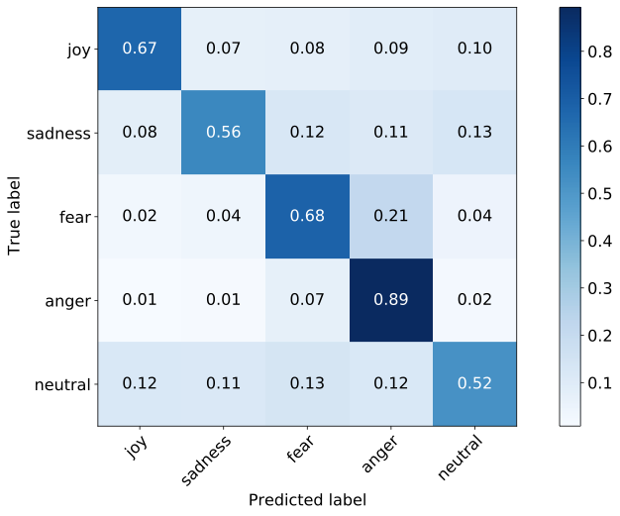
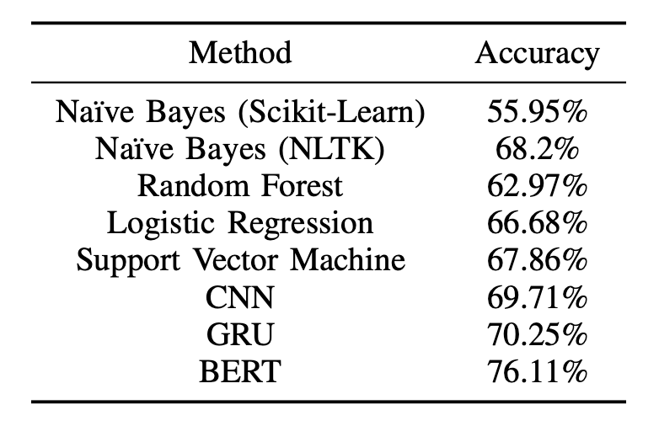
BERT vs. Other Models
Table 1: Multi-class accuracy for all Machine Learning Methods
Fig 6: Normalized Confusion Matrix for BERT Model
Notes:
The overall classification accuracy achieved by training with a BERT model is 76.11\%.The confusion matrix shows the results obtained using BERT. BERT has the best performance in terms of classification accuracy for each emotion. All of the emotions are classified with an accuracy over 50\%, and anger has the highest classification accuracy with up to 89\%. Multi-class accuracies for all machine learning methods considered are shown in the table on the left.

Slide 9
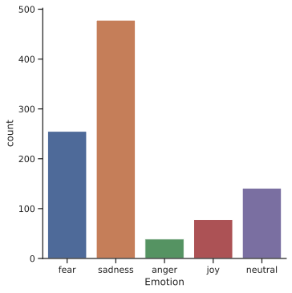
BERT - Emotion Classification Result
Fear and sadness emotions are prevalent among the gang-involved youth and young adults.
The model suggests that it is important for GRYD to further investigate strategies and interventions targeting sadness and fear.
Fig 7: Emotion Classification Result Using BERT Model
Notes:
The emotional distribution of 991 valid responses (after removing NA values) in the open-ended text SET question is shown in this figure. Fear and sadness emotions are prevalent among these gang-involved youth and young adults. Since sadness is the most frequent emotion label and fear is the second most frequent, the model suggests that it is important for GRYD to further investigate strategies and interventions targeting sadness and fear. However, these conclusions are influenced by the model's accuracy on the sadness class, and may vary if accuracy were increased for other classes.

Slide 10
Text classification for Problem and Strategy
Descriptions of different problems (social, health, financial, etc.) vs workshops/services received by participants (strategies)
Use TF-IDF vectorizer, which converts the raw text data to a matrix of feature terms
Use elbow method to determine optimal number of clusters (5 for problems, 5 for strategies)
Apply K-means with designated k=5 to cluster the text
Print out top word centroids in each cluster, manually classify each cluster
Notes:
The ``problem'' column within the SET dataset consists of descriptions of different problems (social, health, financial, etc.) that clients are currently experiencing. The ``strategy'' column in the dataset consists of a number of workshops/services received participants when receiving GRYD FCM services. Classification of these problems and strategies helps us better evaluate the effectiveness of the GRYD FCM Program. The method we used to classify is the $k$-means clustering algorithm. We first prepare the input for the algorithm using \verb!TF-IDF! vectorizer, which converts the raw text data to a matrix of feature terms. Then, the optimal numbers of clusters \textit{k} are determined to be five (for problems) and five (for strategies) using the elbow method.

Slide 11
Visualization of Text Classification Result
Reduced the dimension of feature matrix to 30 with PCA (Principal Component Analysis), allowing us to extract main features of the text and filter out irrelevant noise.
Applied the t-SNE (t-distributed stochastic neighbor embedding) visualization algorithm to create a two-dimensional map from our PCA-reduced text data
Notes:
We take advantage of PCA and t-SNE techniques for dimension reduction and visualizing clustering results. We first reduce the dimension of text data to 30 with PCA, allowing us to extract main features of the text and filter out irrelevant noise. We then apply the t-SNE visualization algorithm to create a two-dimensional map from our PCA-reduced text data.

Slide 12
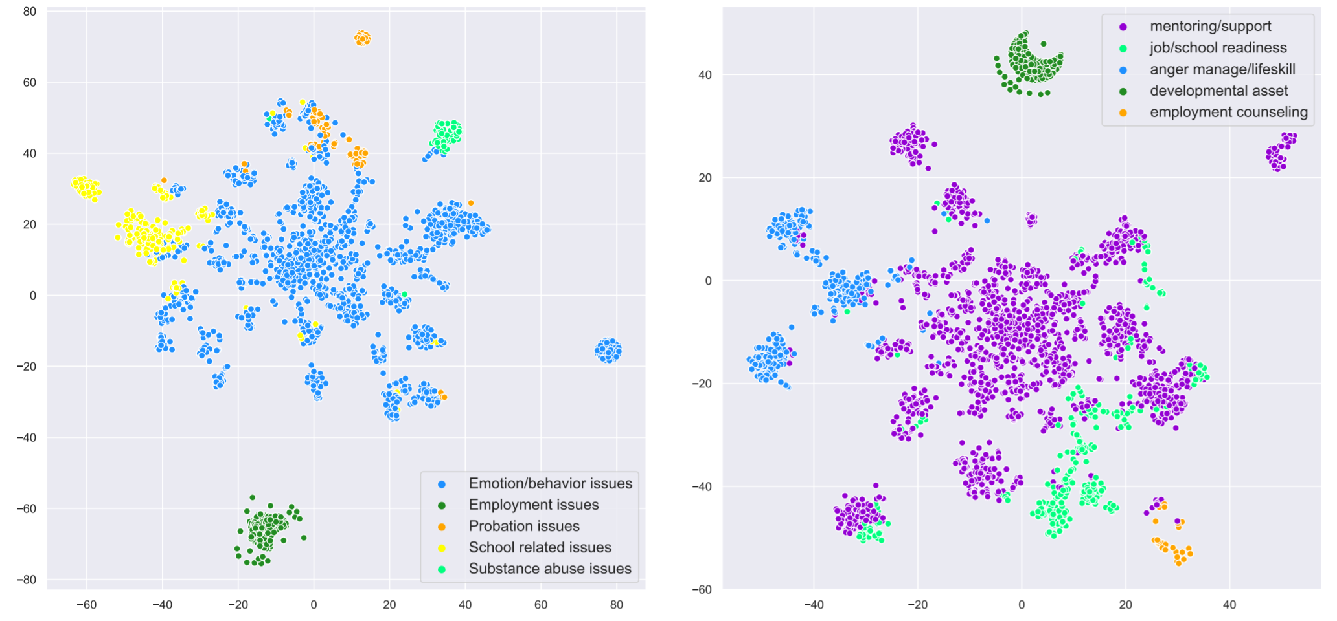
Visualization of Text Classification Result
Notes:
These figures show the results of visualizing the problem and strategy clusters, respectively. In both cases, the majority of clusters seem qualitatively well-separated from one another, suggesting $k$-means clustering is relatively successful on our dataset.

Slide 13
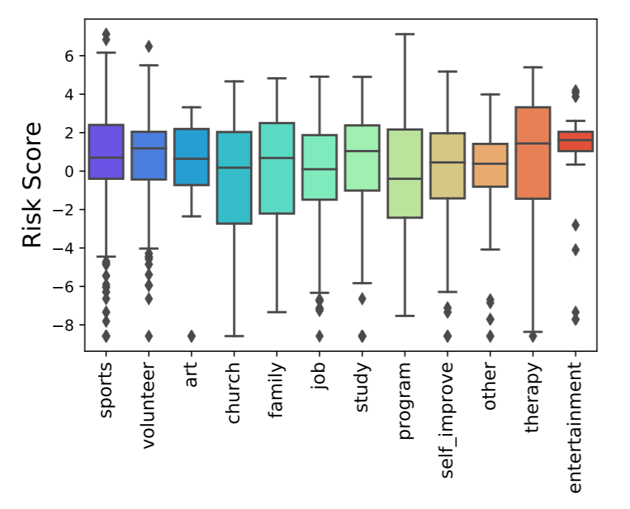
Statistical Analysis of Risk Scores
Entertainment has the highest risk scores.
Activities that require greater commitment, teamwork, responsibility contribute to lower risk.
Notes:
Now, we explore risk score distribution based on SET questionnaire data related to actitives, problems, strategies, and emotions.
One of the free-form questions in the SET dataset asks respondents to ``Describe positive activities.'' We pre-process the raw data by manually grouping the answers into 12 categories.
The boxplot shows how risk scores are distributed for each of these activity categories. We hypothesize that activities that involve greater commitment and reliability, such as jobs, may contribute to lower risk scores.

Slide 14
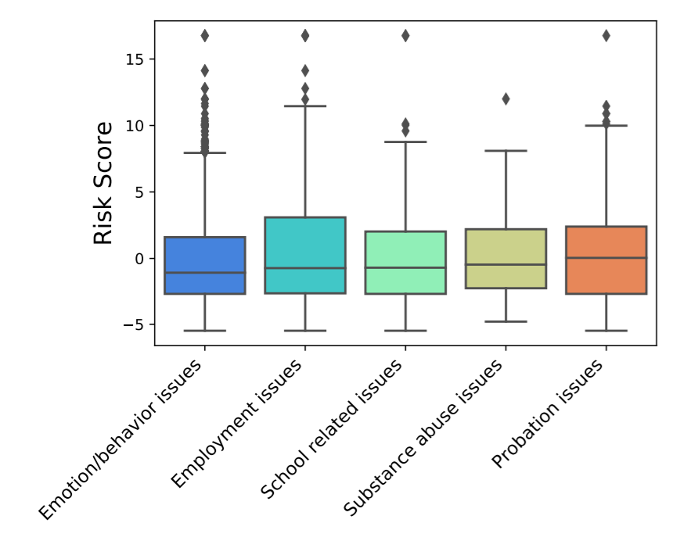
Statistical Analysis of Risk Scores
Problems
Participants who are experiencing probation issues tend to have higher risk score than others.
Notes:
This boxplot shows how risk scores are distributed by each category problem participants face. We observe that participants who are experiencing probation issues tend to have higher risk score than others, though other categories such as emotion/behavior issues exhibit a number of outliers with large risk scores.

Slide 15
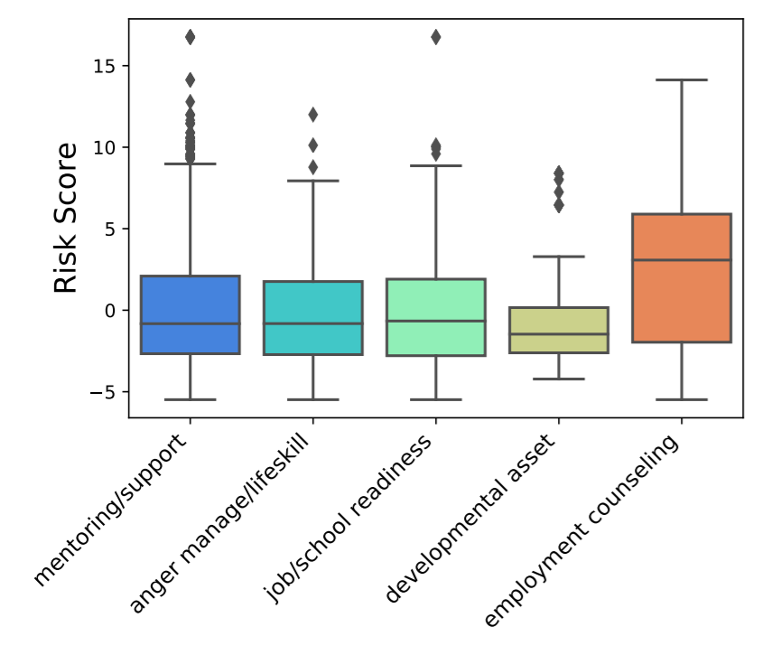
Statistical Analysis of Risk Scores
Strategies
Young adults who are provided with employment counseling services tend to correlate with higher risk score than others.
Notes:
The boxplot here shows how risk scores are distributed by each type of strategy. We can see that young adults who are provided with employment counseling services tend to correlate with higher risk score than others.
Other categories such as mentoring/support exhibit a number of outliers with large risk scores.

Slide 16
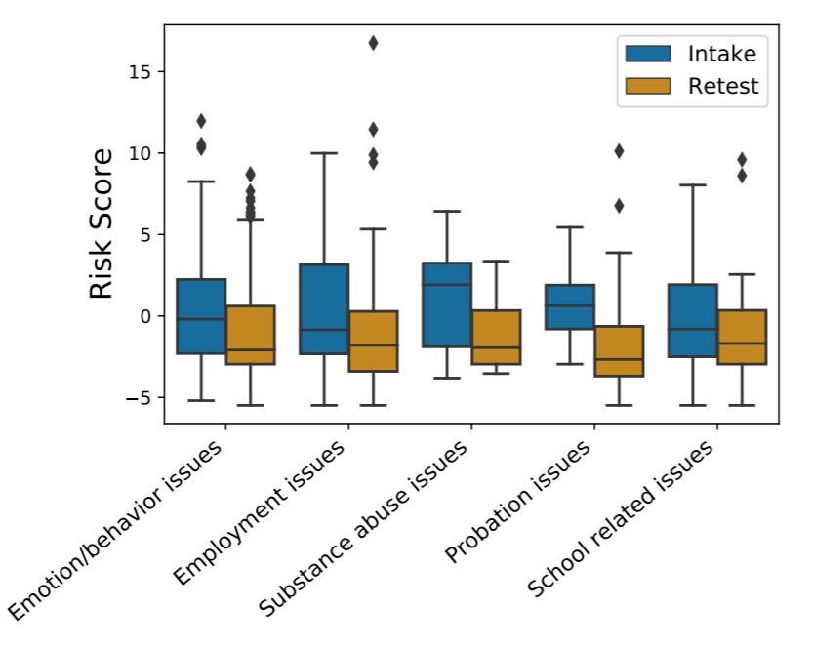
Statistical Analysis of Risk Scores
Change in Risk Scores by problems
Participants who had substance abuse issues and probation issues tend to have significant drops in their risk scores.
Notes:
Within the SET data, some individuals are tested more than once, at different points in time. Accordingly, we consider a subset of the SET data corresponding to SET-Intake and SET-Retest pairs of results. Using this subset of the data, the boxplot here shows that the median risk scores of young adults for all five classes of problems decrease. Most notably, participants who had substance abuse issues and probation issues tend to have significant drops in their median risk score.

Slide 17
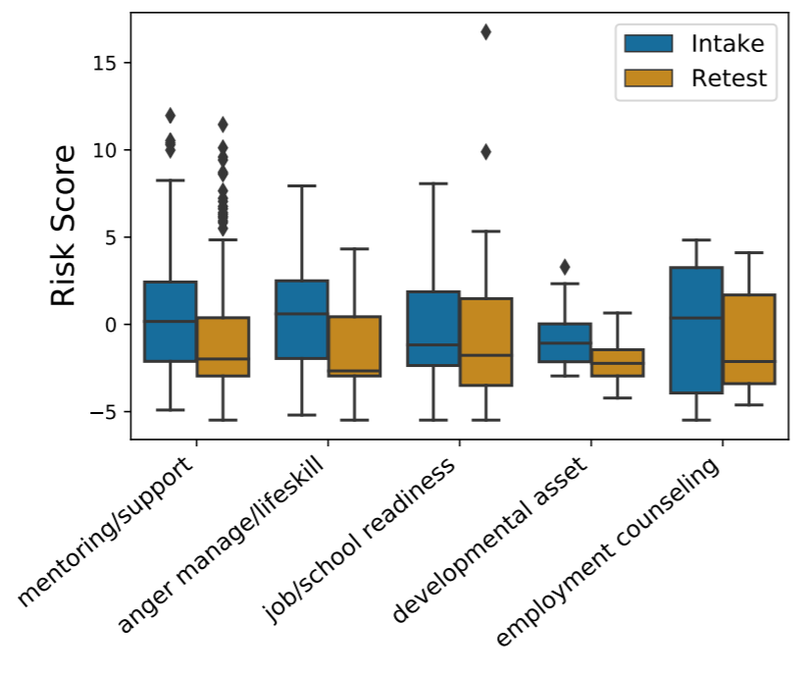
Statistical Analysis of Risk Scores
Change in Risk Scores by strategies
Any type of intervention by GRYD FCM providers is, on average, effective
Young adults who engage in anger management/life skills classes tend to have substantial reductions in their risk score
Those who receive developmental asset have the least reduction
Notes:
Similarly, this boxplot in Figure \ref{fig:strategybox} shows that the median risk scores of young adults for all five classes of strategies decrease. In particular, young adults who engage in anger management/life skills classes tend to have substantial reductions in their risk score while those who receive developmental asset have the least reduction, though this plot suggests that any type of intervention by GRYD FCM providers is, on average, effective.

Slide 18
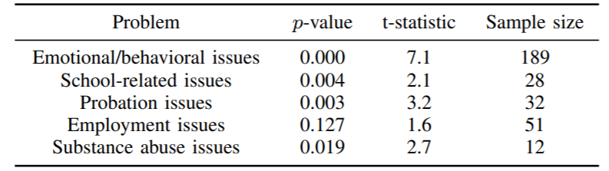
Statistical Analysis of Risk Scores
Significance of Changes in Risk Score by Problems with one-sided paired t-tests
Cannot reject the null hypothesis for individuals who had employment issues
All other categories have significant drops in risk score
Notes:
We performed one-sided paired $t$-tests to see whether the drop in risk score for participants with a specific kind of problem is significant following from SET-Intake to SET-Retest.
Performing these tests reveals that participants who experienced \textbf{emotional/behavioral issues, school-related issues, probation issues, and Substance abuse issues} have significant drops in risk score (see the table). However, we cannot reject the null hypothesis for individuals who had employment issues.

Slide 19
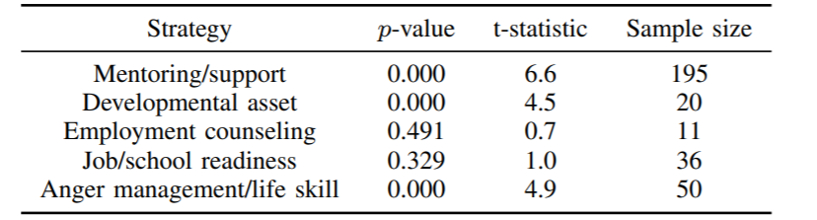
Statistical Analysis of Risk Scores
Significance of Changes in Risk Score by Strategies with one-sided paired t-tests
Strategies focusing on providing Employment counseling and Job/school readiness do not produce sufficient evidence to reject the null hypothesis
Other three categories have significant drops in risk score
Notes:
We also applied one-sided paired $t$-tests to analyze the significance of reductions in risk scores for participants who were treated with various strategies offered by the GRYD FCM Program. From these tests, we conclude that strategies in the \textbf{mentoring/support, developmental Asset, \textnormal{and} anger management/life skill} are effective since they all have $p$-values less than 0.05.

Slide 20
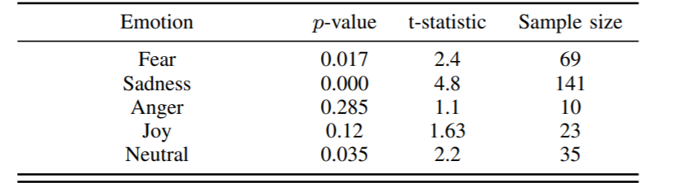
Statistical Analysis of Risk Scores
Significance of Changes in Risk Score by Emotions with one-sided paired t-tests
Not enough evidence to suggest that participants exhibiting “anger” and “joy” have significant drops in risk score
Participants exhibiting other three emotions have significant drops in risk score
Notes:
We also conduct one-sided paired $t$-tests on the emotion classes. Based on the p values from the $t$-tests, there is not enough evidence to suggest that participants exhibiting ``anger'' and ``joy'' have significant drops in risk score from SET-Intake to SET-Retest. However, we are able to conclude that participants exhibiting other emotions do have a significant drop in risk score. This suggests GRYD FCM provider interventions are effective in reducing risk score for most subpopulations, when partitioning the population by emotion label

Slide 21
Summary & Conclusions
We explored how risk scores of GRYD participants depend on their answers to several free-form text questions.
We applied NLP techniques for labeling the emotions conveyed in their responses.
We also studied responses related to participants' other (non-gang) activities, their problems, and the GRYD intervention strategies they were exposed to.
These results suggest strengths of existing GRYD interventions as well as areas where GRYD can further investigate
Notes:
We explored how risk scores of GRYD FCM participants who completed the SET questionnaire depend on their answers to several free-form text questions. We applied NLP techniques for labeling the emotions conveyed in these responses. We also studied responses related to participants' other (non-gang) activities, their problems, and the GRYD FCM intervention strategies they were exposed to. While these analyses revealed interesting insights on their own, we further considered how participants' risk scores changed over time, breaking down the population by several different factors. We found statistically significant changes for many---but not all---subsets of the population. These results suggest strengths of existing GRYD FCM interventions as well as areas where GRYD FCM can further investigate.

Slide 22
Thanks for listening!
Acknowledgements: We adapted Python notebooks on machine learning by Lukas Garbas for training models on our chosen datasets.
The SET was created by the City of Los Angeles Mayor’s Office of Gang Reduction and Youth Development and is the copyright of the City of Los Angeles and has been used with permission. Any opinions, findings, conclusions or recommendations expressed in this study, however, are those of the authors and do not necessarily reflect the views of the GRYD Office. This research was funded by the City of Los Angeles contract number C-132202 (“GRYD Research and Evaluation”).

